Slide 1

AI training group
Weekly Report
Nguyen khai phu – Aug 4 2023

Slide 2
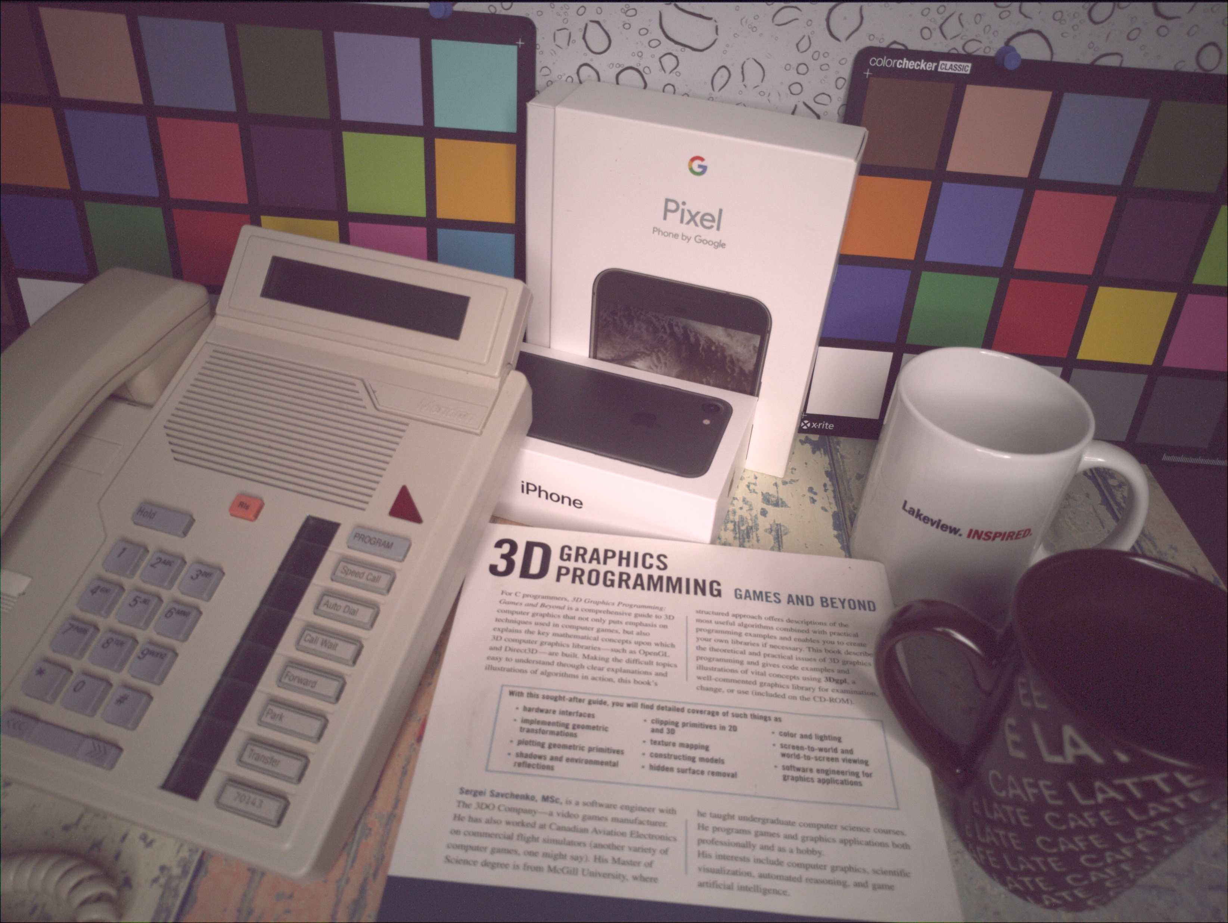
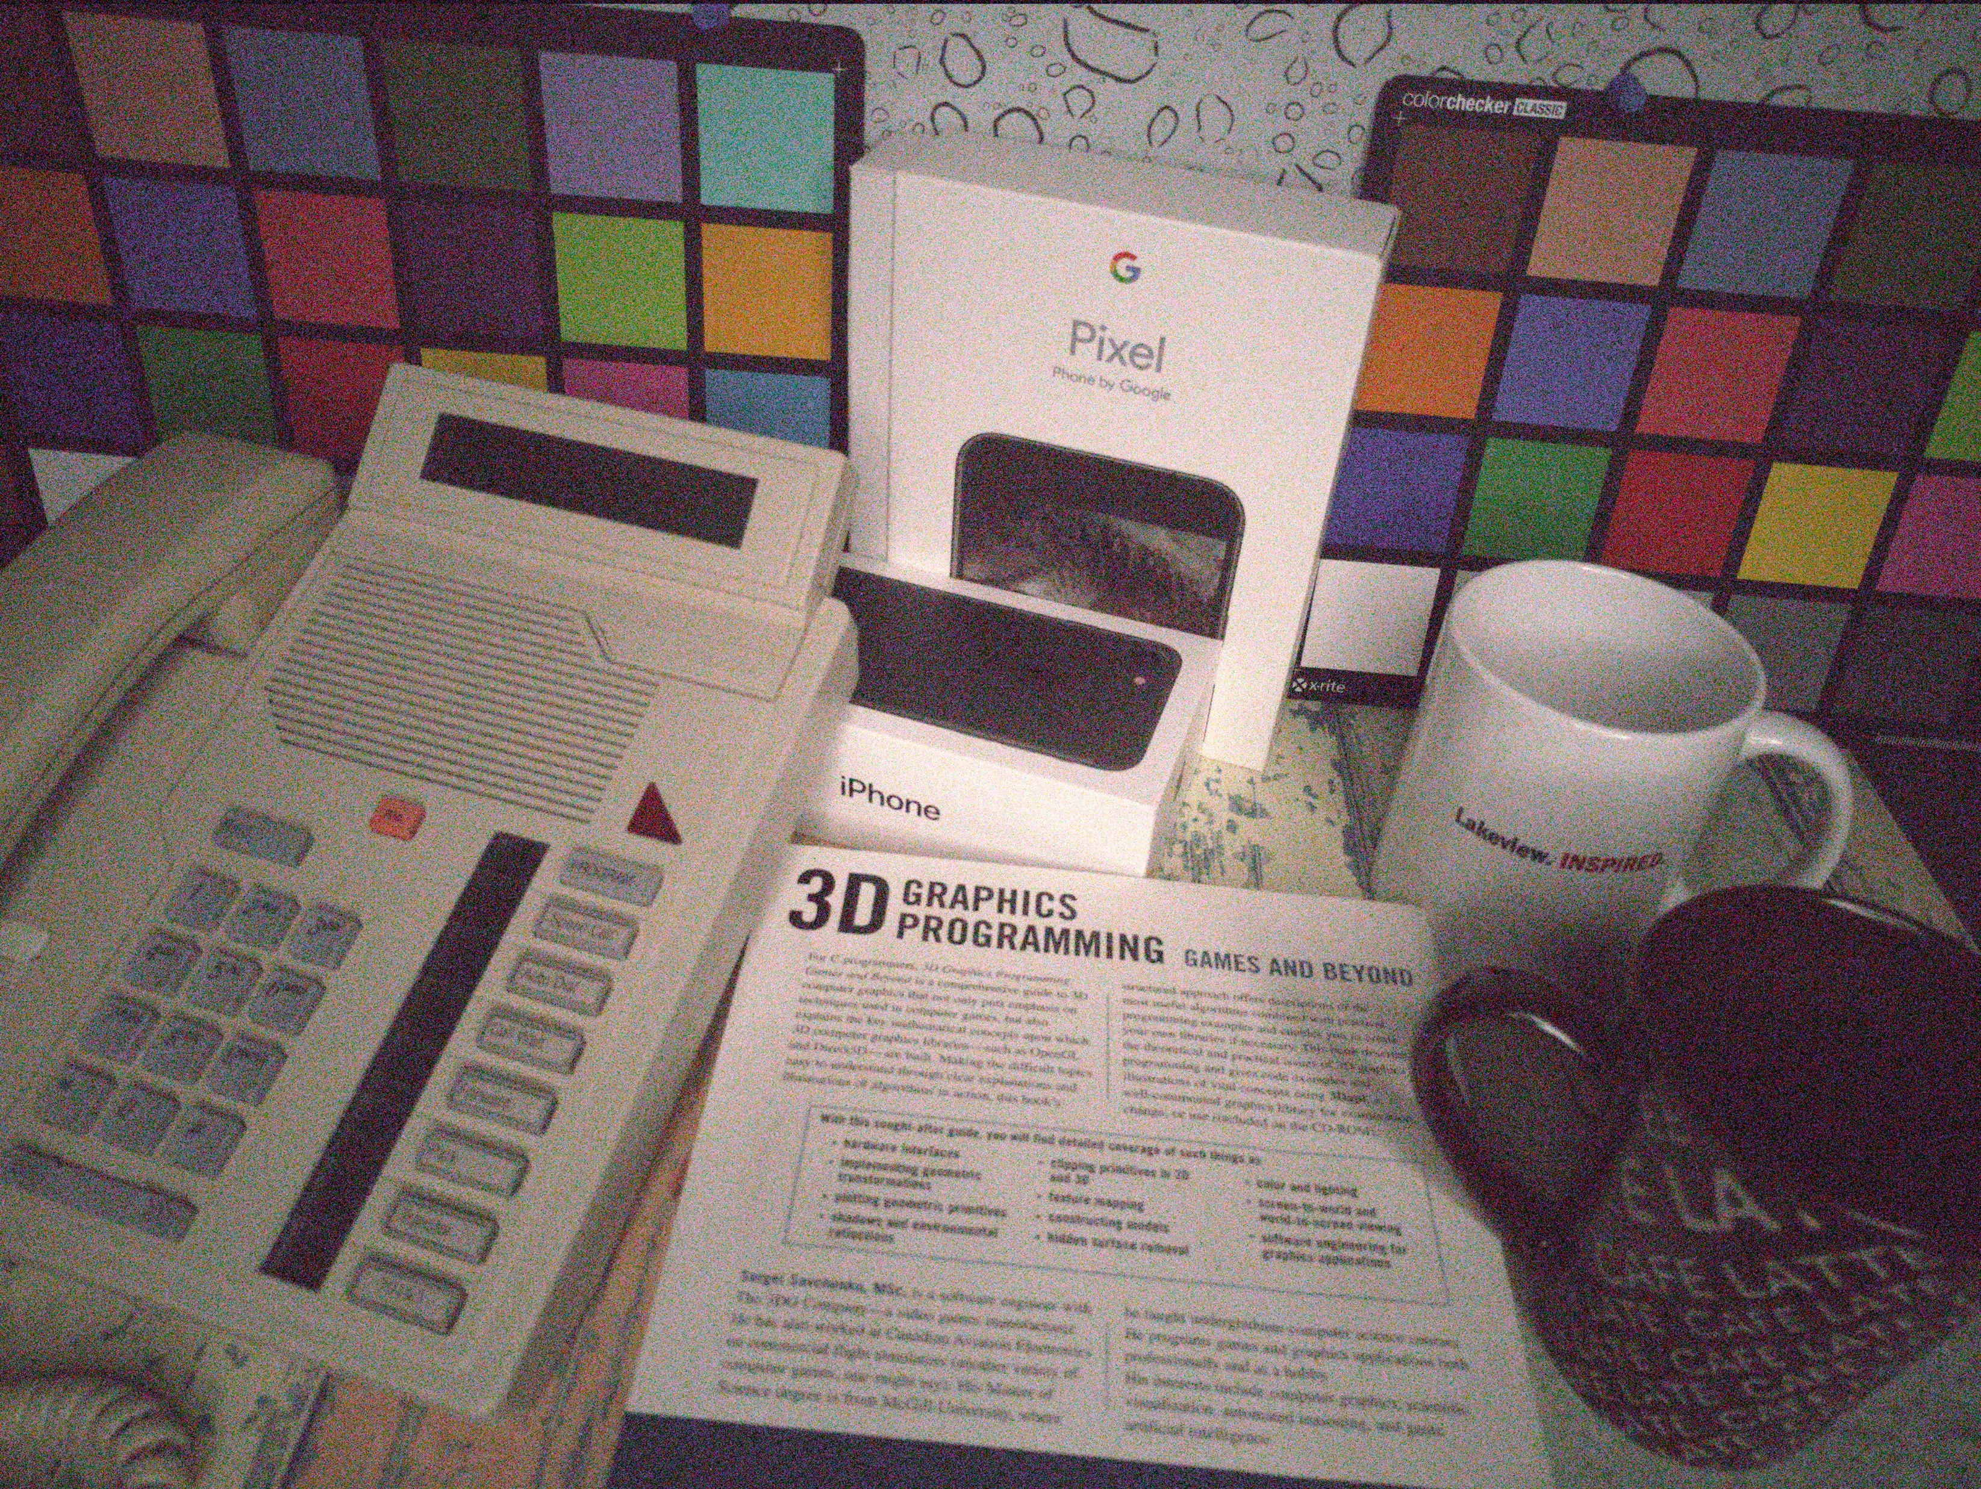
Impulse noise
ISP008 foundation
2
Internal | C/ISP Krautschneider | 07.12.2017 V1.0
CISP-1352-A21 - ISP-DOC-STYLETYPE-Templates © Robert Bosch GmbH 2016. All rights reserved, also regarding any disposal, exploitation, reproduction, editing, distribution, as well as in the event of applications for industrial property rights.

Slide 3
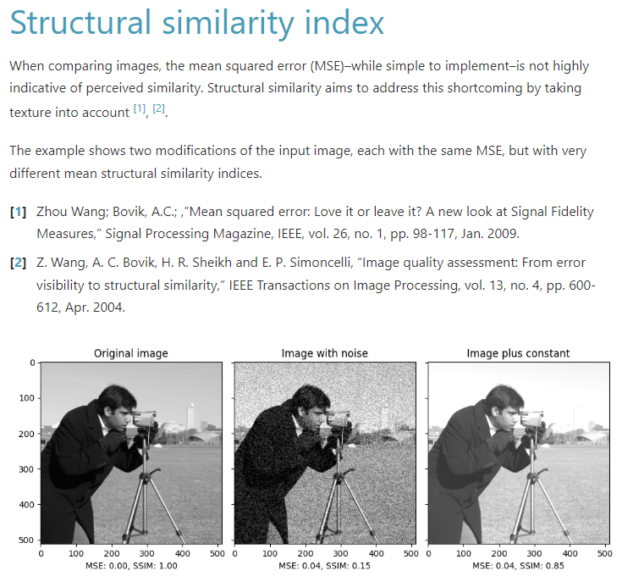
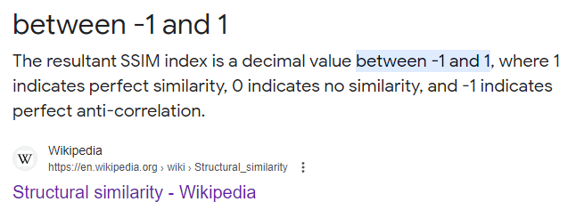
Structural similarity (SSIM)
ISP008 foundation
2
CISP-1352-A21 - ISP-DOC-STYLETYPE-Templates © Robert Bosch GmbH 2016. All rights reserved, also regarding any disposal, exploitation, reproduction, editing, distribution, as well as in the event of applications for industrial property rights.

Slide 4
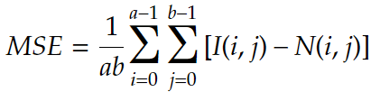
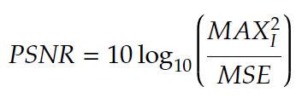
Structural similarity (SSIM)
ISP008 foundation
Measuring Image similarity - Quick overview:
Mean Squared Error (MSE): average squared difference between original image I (a x b) and noisy image N, pixel by pixel
Peak Signal-to-noise ratio (PSNR): the ratio between the maximum possible pixel value (e.g. 255 for 8-bit) and the noise that affects the pixels’ quality (usually defined as MSE)
2
CISP-1352-A21 - ISP-DOC-STYLETYPE-Templates © Robert Bosch GmbH 2016. All rights reserved, also regarding any disposal, exploitation, reproduction, editing, distribution, as well as in the event of applications for industrial property rights.

Slide 5
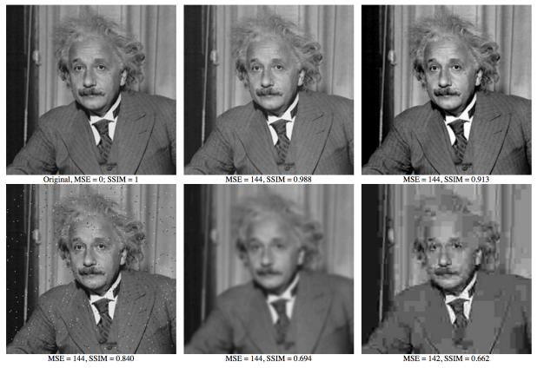
Structural similarity (SSIM)
ISP008 foundation
Measure similarity between two images
Align with human perception
3 elements:
Luminosity
Contrast
Structural similarity
2
CISP-1352-A21 - ISP-DOC-STYLETYPE-Templates © Robert Bosch GmbH 2016. All rights reserved, also regarding any disposal, exploitation, reproduction, editing, distribution, as well as in the event of applications for industrial property rights.

Slide 6
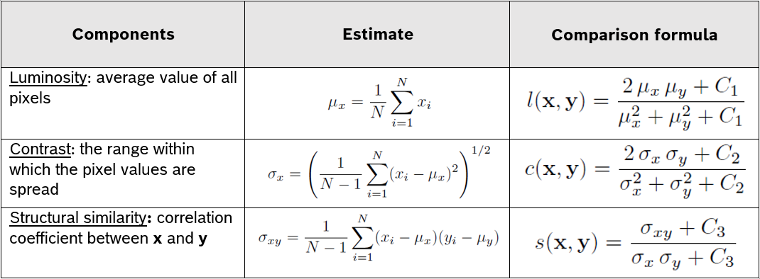
Structural similarity (SSIM)
ISP008 foundation
Consider 2 image signals x and y:
We can then assign weights for the results of 3 comparison formulas, in order to adjust their relative importance
2
CISP-1352-A21 - ISP-DOC-STYLETYPE-Templates © Robert Bosch GmbH 2016. All rights reserved, also regarding any disposal, exploitation, reproduction, editing, distribution, as well as in the event of applications for industrial property rights.

Slide 7
Datasets
ISP008 foundation
Impulse noise: SIDD Medium - 12GB, 320 pairs of noisy/ground truth images
Blur
Periodic noise
Glitches
Scratches and blotches
Snow
Freeze frame
2
CISP-1352-A21 - ISP-DOC-STYLETYPE-Templates © Robert Bosch GmbH 2016. All rights reserved, also regarding any disposal, exploitation, reproduction, editing, distribution, as well as in the event of applications for industrial property rights.

Slide 8
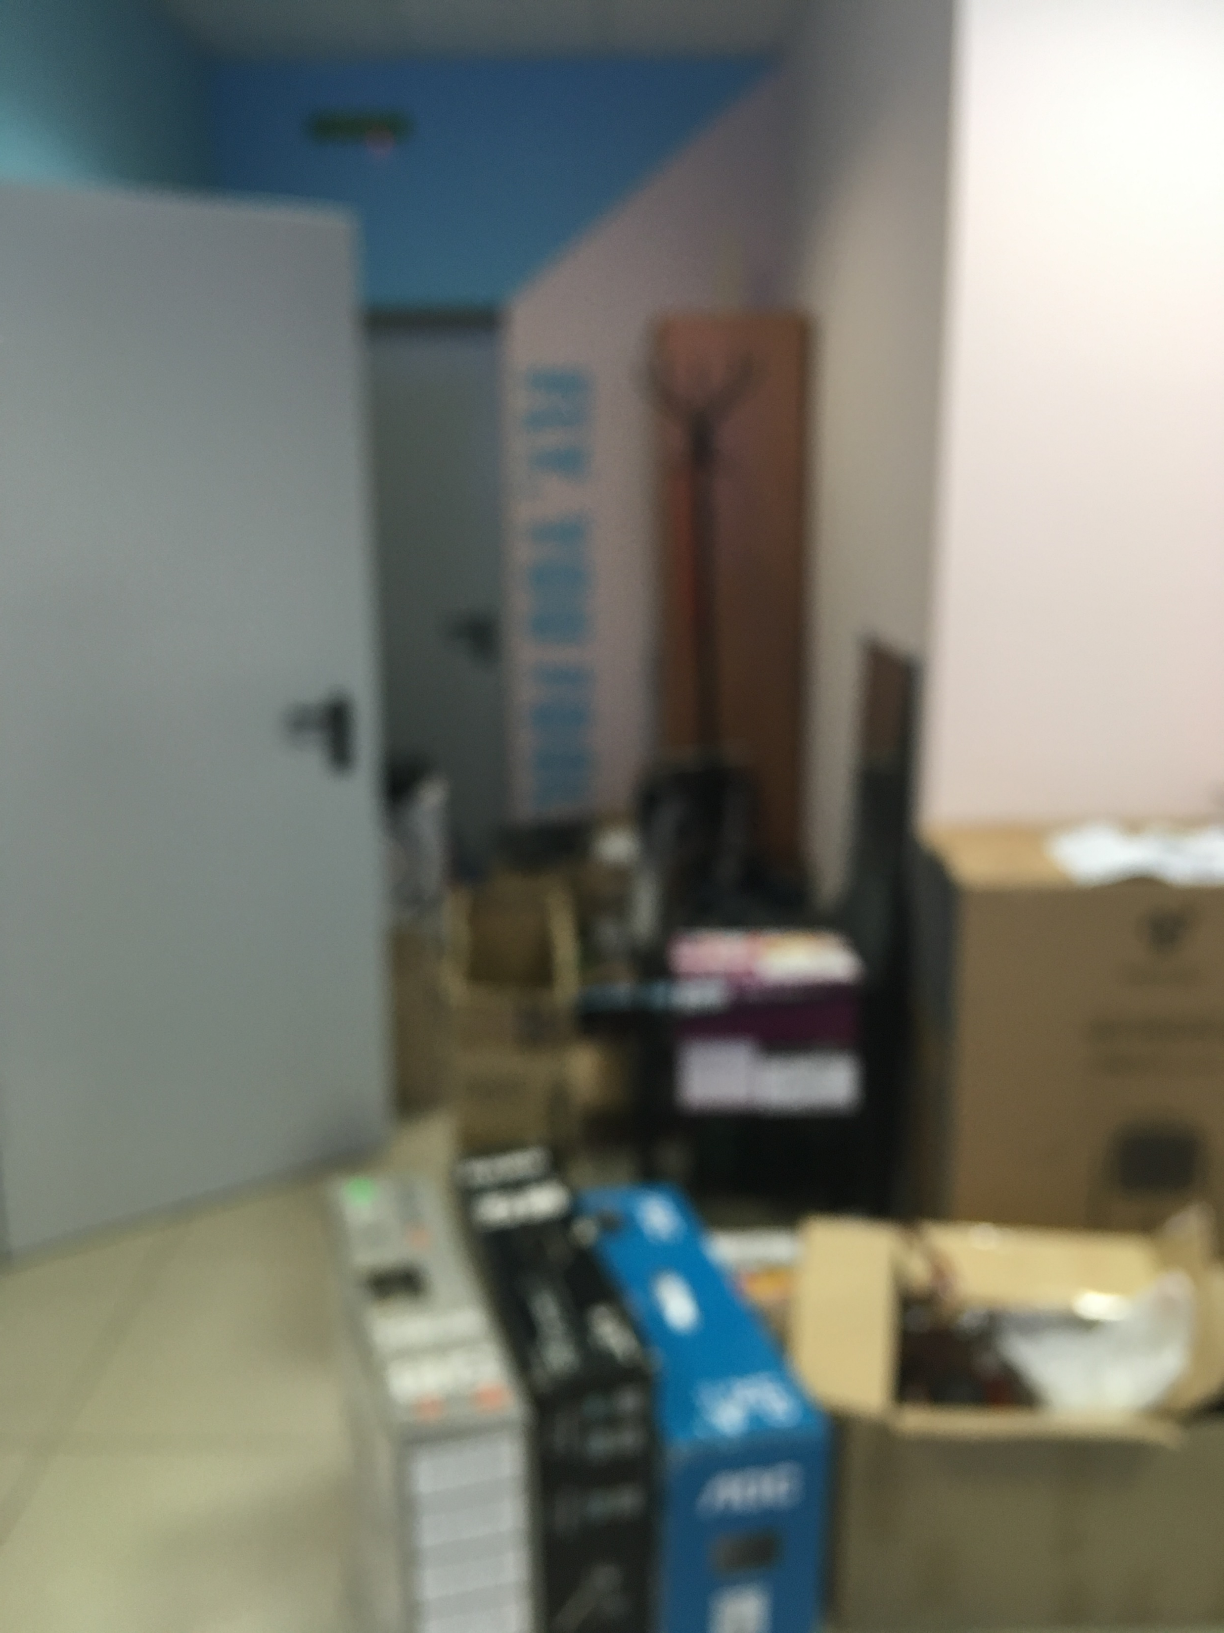
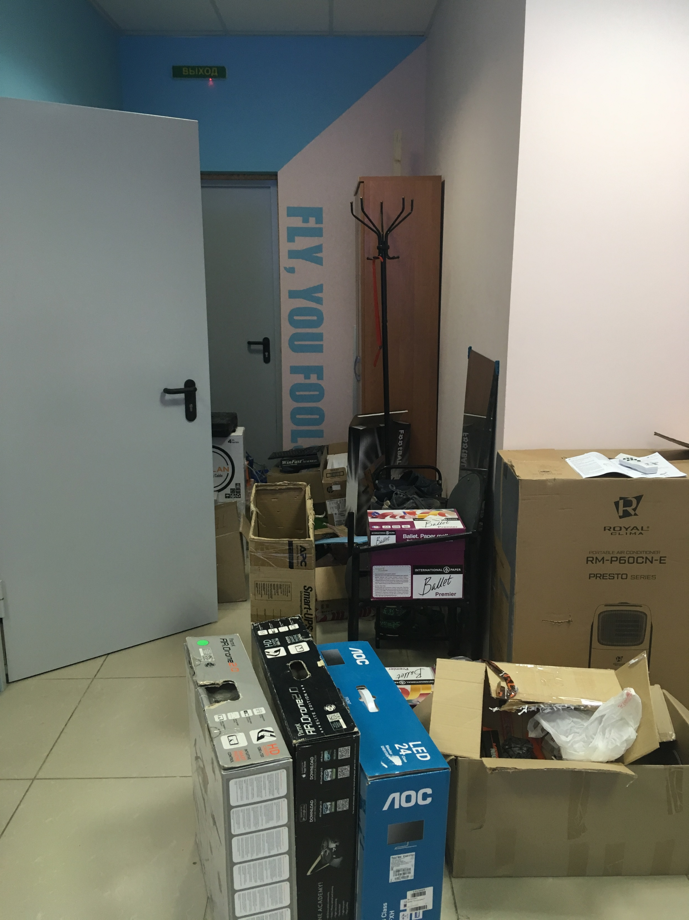
Datasets
ISP008 foundation
Impulse noise: SIDD Medium - 12GB, 320 pairs of noisy/ground truth images
Blur: Blur dataset | Kaggle – 700 pairs of blurred/sharp images
Periodic noise
Glitches
Scratches and blotches
Snow
Freeze frame
2
CISP-1352-A21 - ISP-DOC-STYLETYPE-Templates © Robert Bosch GmbH 2016. All rights reserved, also regarding any disposal, exploitation, reproduction, editing, distribution, as well as in the event of applications for industrial property rights.

Slide 9
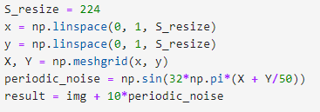
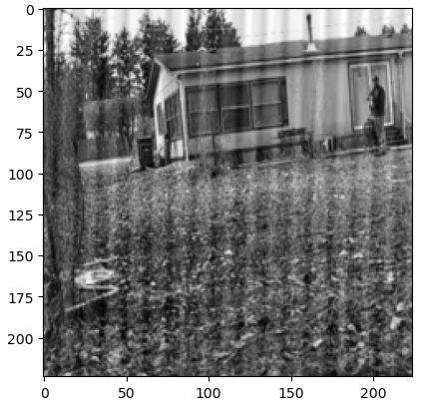
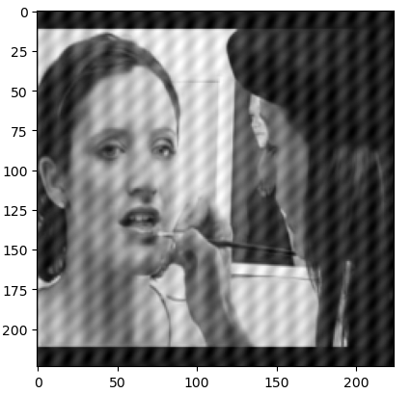
Datasets
ISP008 foundation
Impulse noise: SIDD Medium - 12GB, 320 pairs of noisy/ground truth images
Blur: Blur dataset | Kaggle – 700 pairs of blurred/sharp images
Periodic noise
Glitches
Scratches and blotches
Snow
Freeze frame
2
CISP-1352-A21 - ISP-DOC-STYLETYPE-Templates © Robert Bosch GmbH 2016. All rights reserved, also regarding any disposal, exploitation, reproduction, editing, distribution, as well as in the event of applications for industrial property rights.

Slide 10
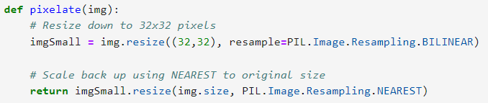
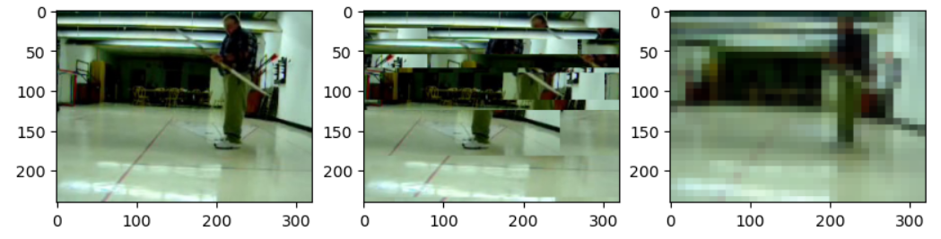
Datasets
ISP008 foundation
Impulse noise: SIDD Medium - 12GB, 320 pairs of noisy/ground truth images
Blur: Blur dataset | Kaggle – 700 pairs of blurred/sharp images
Periodic noise
Glitches: glitch-this, pixelate
Scratches and blotches
Snow
Freeze frame
2
CISP-1352-A21 - ISP-DOC-STYLETYPE-Templates © Robert Bosch GmbH 2016. All rights reserved, also regarding any disposal, exploitation, reproduction, editing, distribution, as well as in the event of applications for industrial property rights.

Slide 11
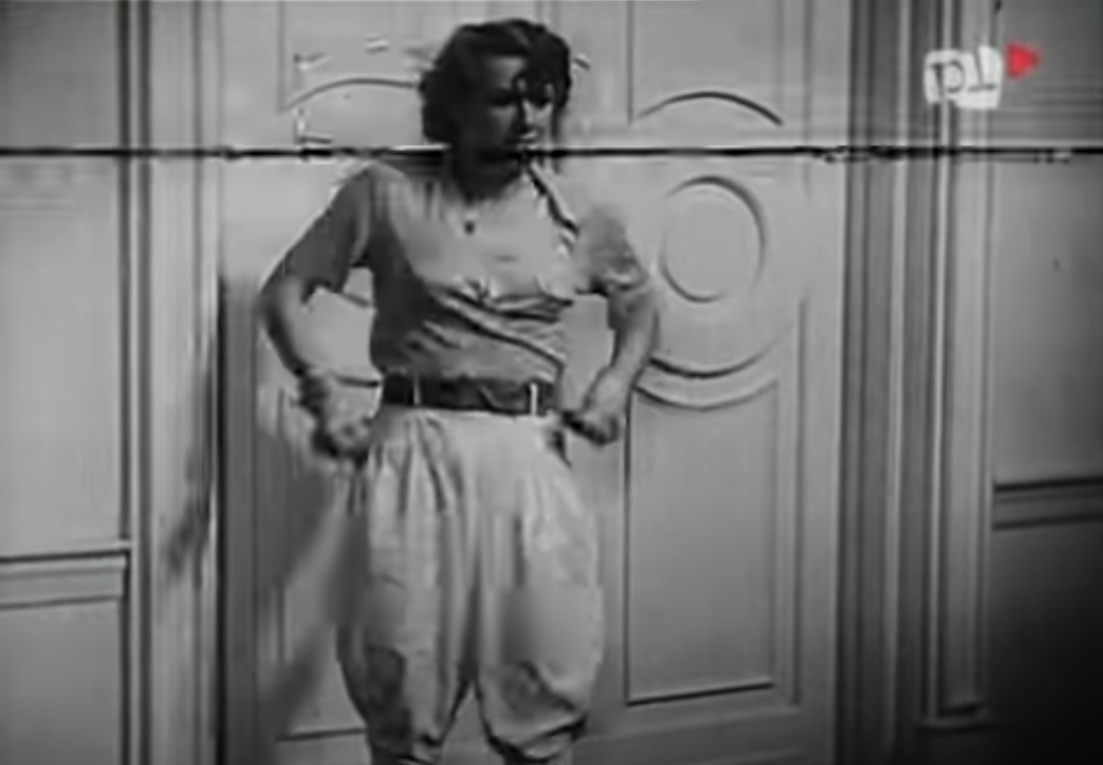
Datasets
ISP008 foundation
Impulse noise: SIDD Medium - 12GB, 320 pairs of noisy/ground truth images
Blur: Blur dataset | Kaggle – 700 pairs of blurred/sharp images
Periodic noise
Glitches: glitch-this, pixelate
Scratches and blotches: W starym kinie - Manewry miłosne (1935) - YouTube
Snow
Freeze frame
2
CISP-1352-A21 - ISP-DOC-STYLETYPE-Templates © Robert Bosch GmbH 2016. All rights reserved, also regarding any disposal, exploitation, reproduction, editing, distribution, as well as in the event of applications for industrial property rights.

Slide 12
Reference
ISP008 foundation
A brief Introduction to Structural Similarity Index(SSIM) – Rahul Deora – Understanding the World through Machine Learning Heuristics (bluesky314.github.io)
https://en.wikipedia.org/wiki/Peak_signal-to-noise_ratio
ssim.pdf (uwaterloo.ca)
2
Internal | C/ISP Krautschneider | 07.12.2017 V1.0
CISP-1352-A21 - ISP-DOC-STYLETYPE-Templates © Robert Bosch GmbH 2016. All rights reserved, also regarding any disposal, exploitation, reproduction, editing, distribution, as well as in the event of applications for industrial property rights.

